Slide 1
Advanced Computer Vision
THU×SENSETIME – 80231202
Chapter 2 - Section 8
Recap and Image Segmentation
Dr. Li Hongyang
Friday, April 9, 2021
Partial credit by : Wang Cheng

Slide 2
Part 1 | Recap: classification loss and detection pipeline
Part 2 | Image segmentation
Part 3 | Building up your research career
Outline

Slide 3
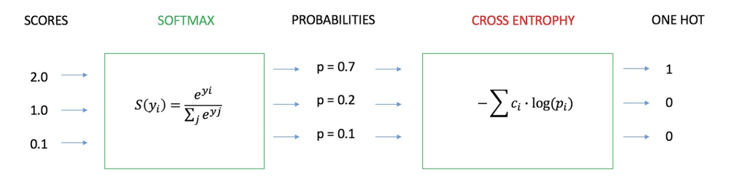
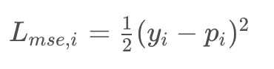
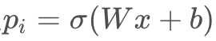
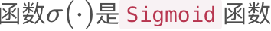
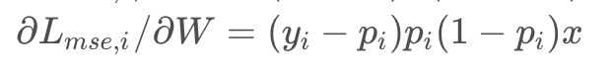
Recap: Image Classification
Classification Loss
Cross entropy or MSE?
For MSE loss, we have
The grad for MSE loss is:
Wx+b could be very large/small in the first few iterations; since parameters are randomly initialized.
Gradient vanishing!

Slide 4
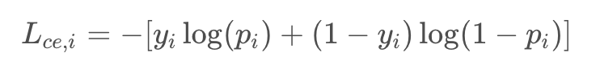
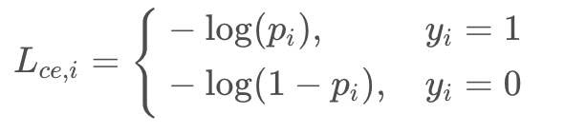
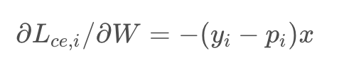
Recap: Image Classification
Classification Loss
Cross entropy or MSE?
For Cross entropy loss, we have
Equivalent
The grad for CE loss is:
Gradient vanishing! resolved

Slide 5
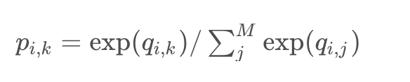
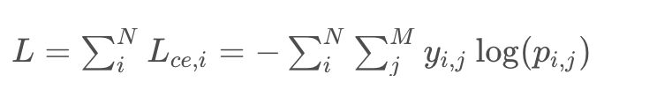
Recap: Image Classification
Classification Loss
Cross entropy or MSE?
Multi-classification CE loss:
Further extension:
From cross entropy loss to Focal loss and Circle loss
What’s the relationship?
Notes:
https://blog.csdn.net/qq_39732684/article/details/105794637

Slide 6
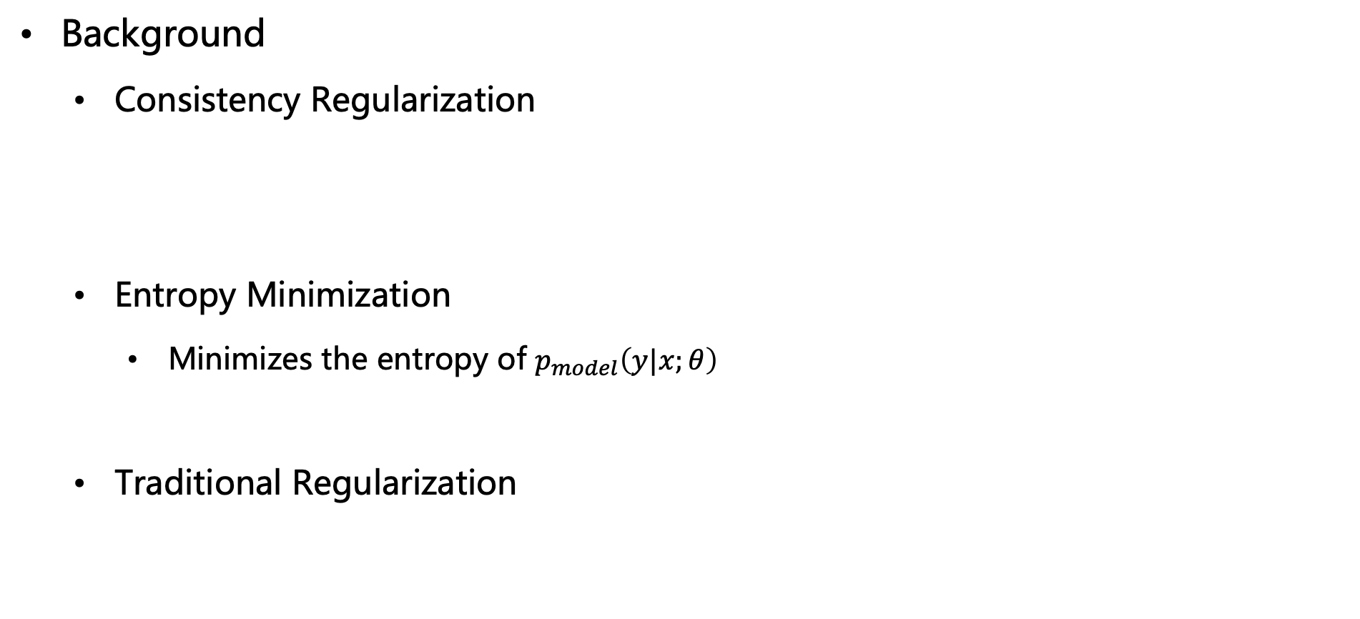
Pseudo-Labelling
Background
Consistency Regularization
Entropy Minimization
Minimizes the entropy of $p_{model}\left(y|x;θ\right)$
Traditional Regularization
模型在无标签数据 增广前 和 增广后 的预测应该一致
要求分类器对无标签样本输出熵较少的结果
加入一些常量干扰，使得模型难以记住训练样本，来达到泛化要求
Notes:
一致性约束：模型在无标签数据增广前和增广后的预测应该一致
熵最小化：分类器的决策边界不应该经过高密度区域。因此要求分类器对无标签样本输出熵较少的结果。“Pseudo-Label” does entropy minimization implicitly by constructing hard (1-hot) labels from high-conﬁdence predictions on unlabeled data and using these as training targets in a standard cross-entropy loss.
通用正则化：加入一些常量干扰，使得模型难以记住训练样本，来达到泛化要求

Slide 7
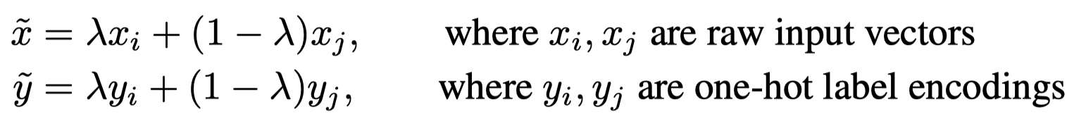
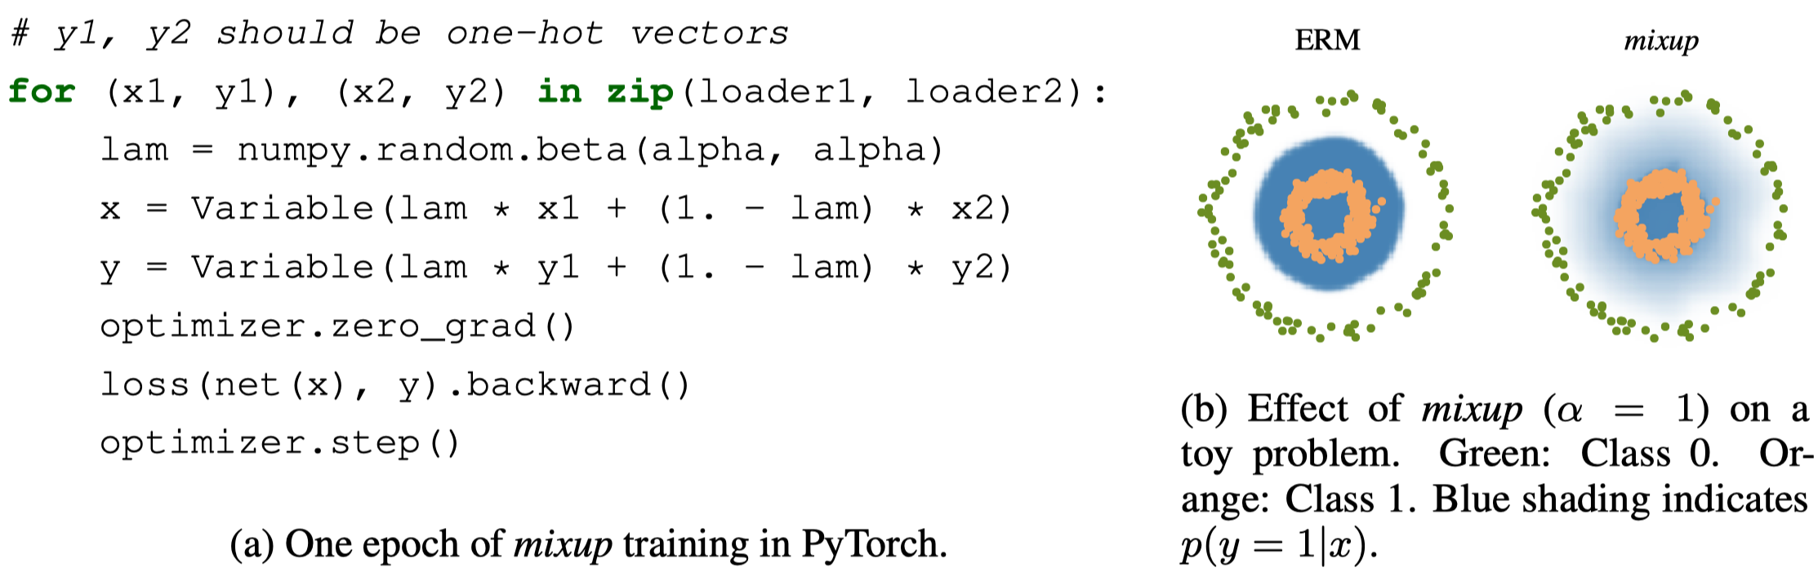
Pseudo-Labelling
Mixup: Beyond Empirical Risk Minimization (经验风险最小化；训练误差越小越好)
A simple and data-agnostic data augmentation method
Zhang H, Cisse M, Dauphin YN, Lopez-Paz D. mixup: Beyond empirical risk minimization. arXiv preprint arXiv:1710.09412. 2017 Oct 25.

Slide 8
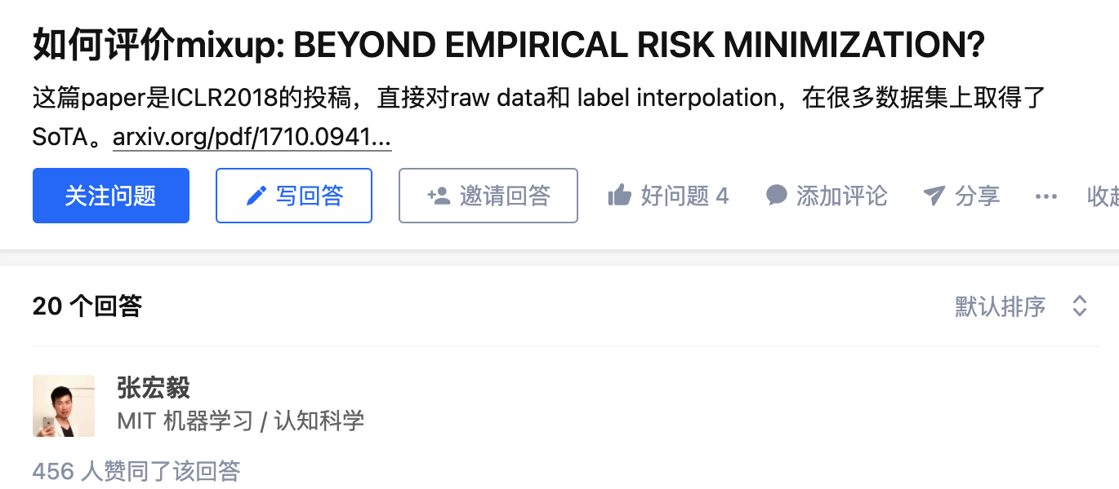
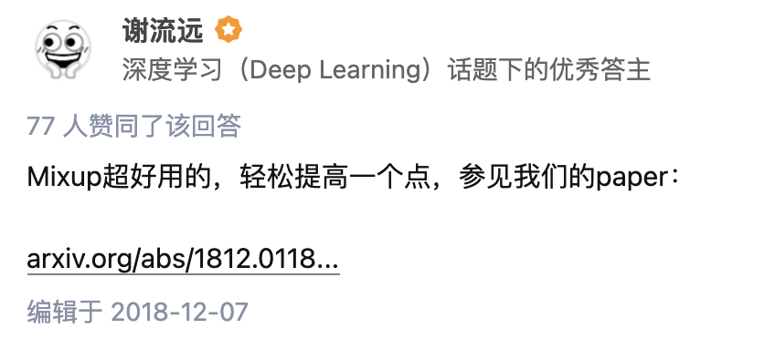
Pseudo-Labelling
mixup: Beyond Empirical Risk Minimization
Why use beta distribution?
Similar to label smooth?
Why mixup works? (Generalization gap between training data and real data)
https://www.zhihu.com/question/67472285
Notes:
Beta 分布在 alpha 小于 1 时，取值在 0 或 1 附近，即 mixup 期望的是轻微扰动，而不是 0.5 * x1 + 0.5 * x2 这种大的图像变化
Label smooth 也有助于预防过拟合，优化时使用的也不是 one-hot label

Slide 9
Pseudo-Labelling
mixup: Beyond Empirical Risk Minimization
Further reading
MixMatch
ReMixMatch
FixMatch

Slide 10
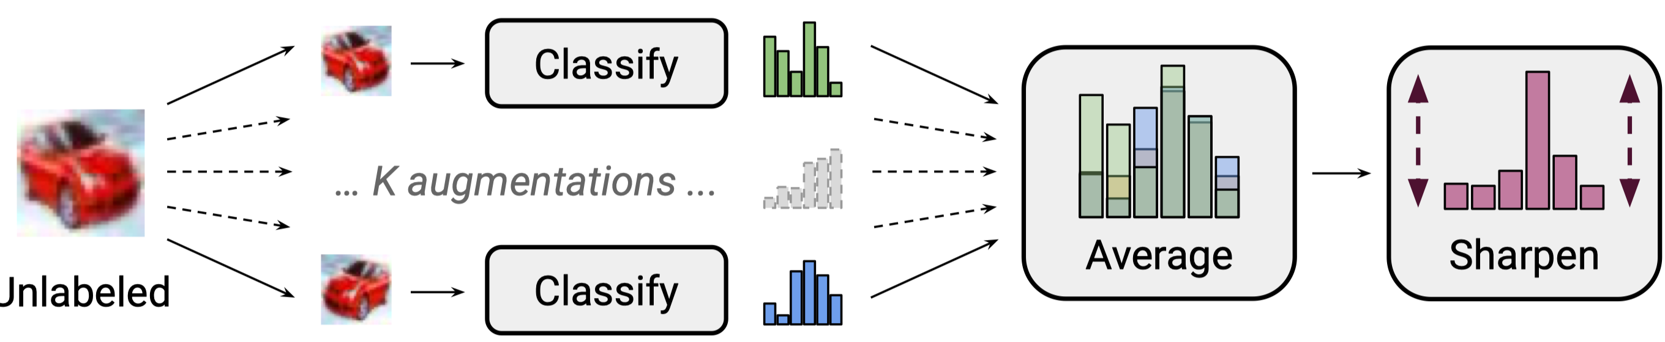
Pseudo-Labelling
MixMatch: A Holistic Approach to Semi-Supervised Learning
Stochastic data augmentation is applied to an unlabeled image K times
The average of these K predictions is “sharpened” by adjusting the distribution’s temperature
Berthelot D, Carlini N, Goodfellow I, Papernot N, Oliver A, Raffel C. Mixmatch: A holistic approach to semi-supervised learning. arXiv preprint arXiv:1905.02249. 2019 May 6.

Slide 11
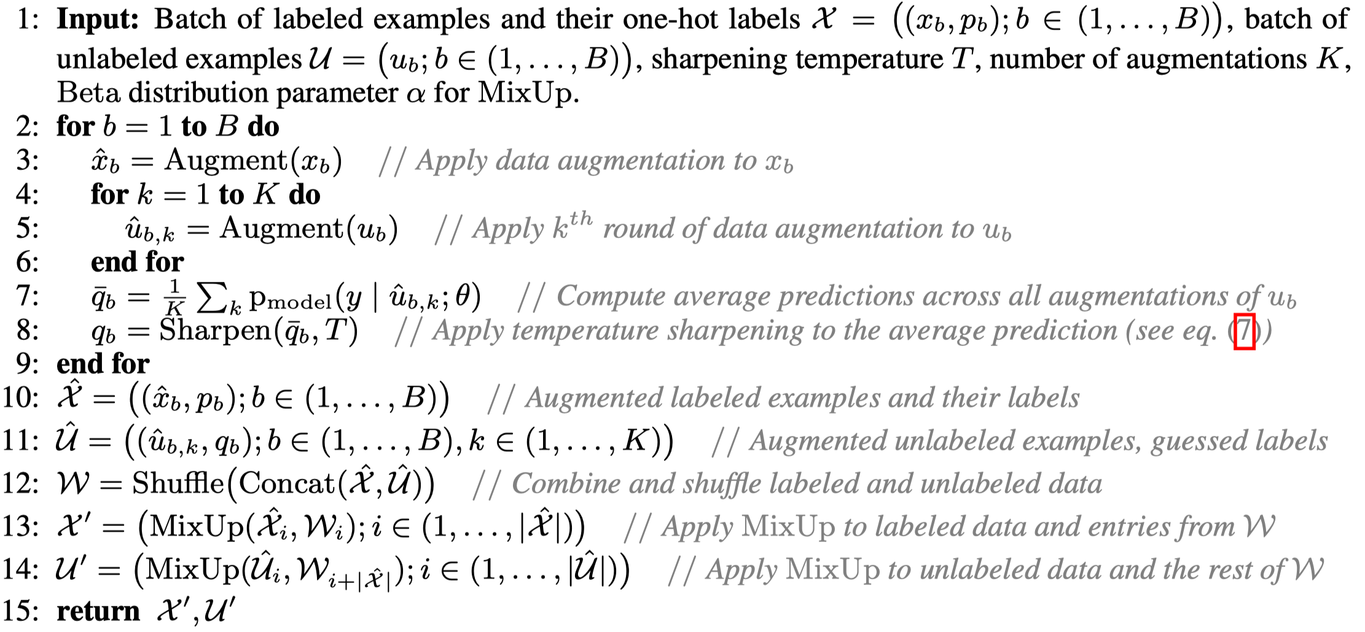
Pseudo-Labelling
MixMatch: A Holistic Approach to Semi-Supervised Learning

Slide 12
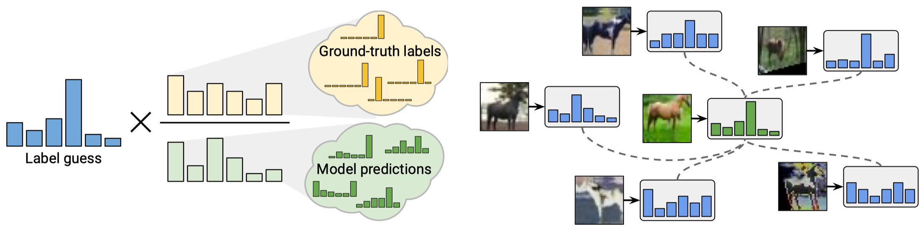
Pseudo-Labelling
ReMixMatch: Semi-Supervised Learning with Distribution Matching and Augmentation Anchoring
Improved version of MixMatch
Distribution Alignment (left) and Augmentation Anchor (right)
Berthelot D, Carlini N, et al. Remixmatch: Semi-supervised learning with distribution alignment and augmentation anchoring. arXiv preprint arXiv:1911.09785. 2019 Nov 21.

Slide 13
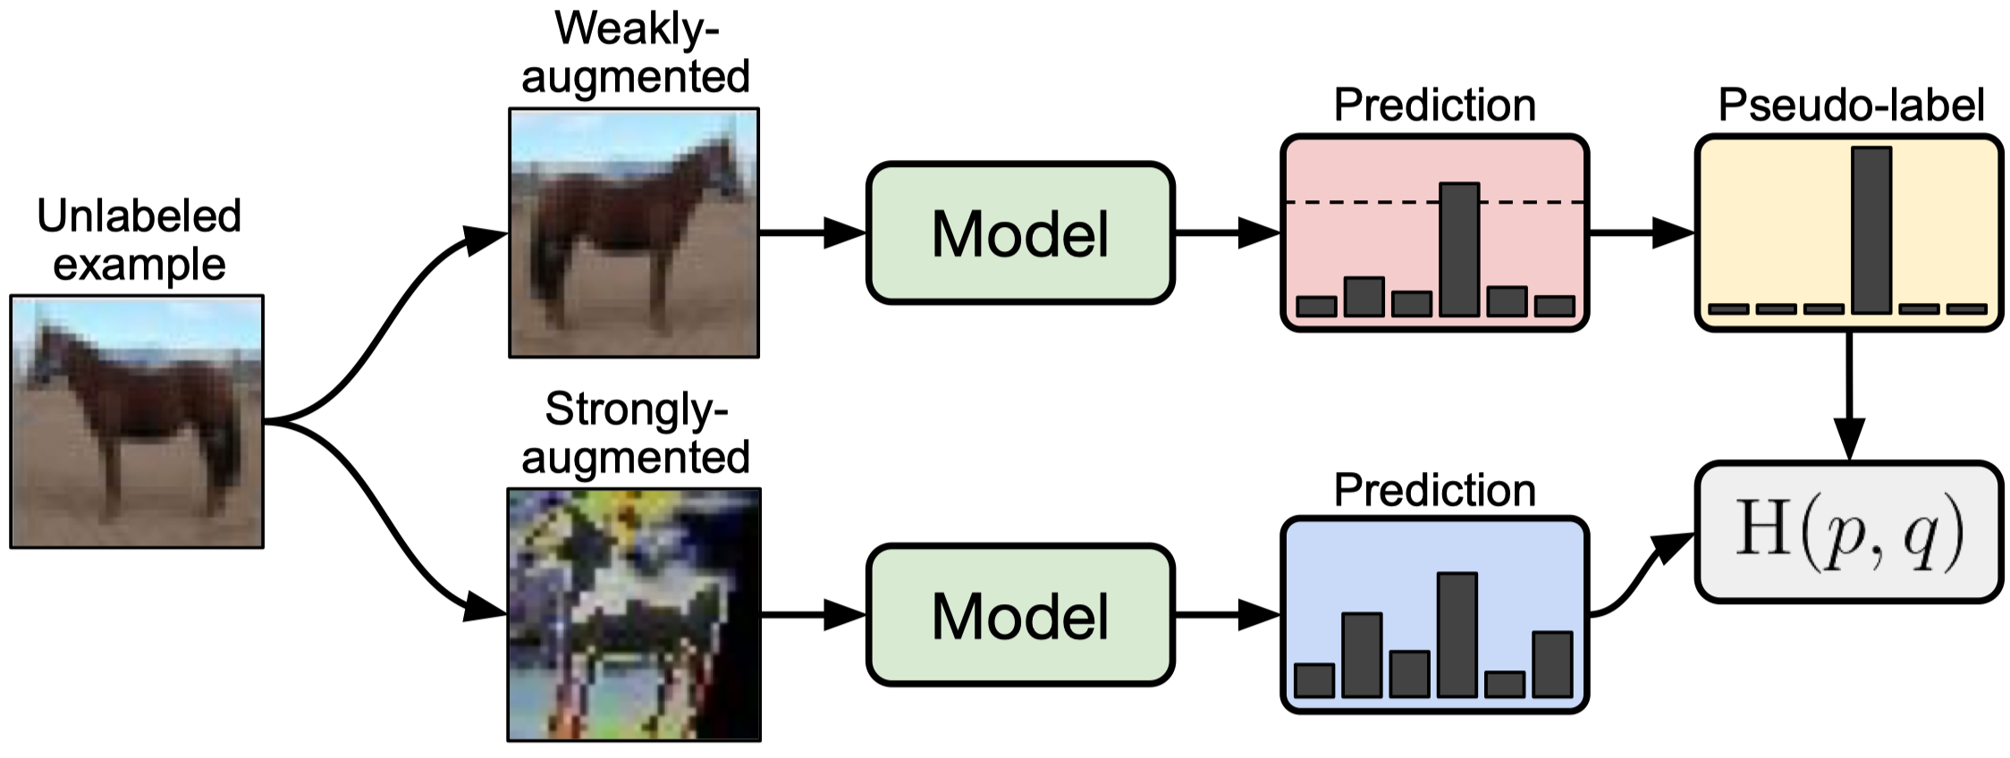
Pseudo-Labelling
FixMatch: Simplifying Semi-Supervised Learning with Consistency and Confidence
Combination of Consistency regularization and pseudo-labeling.
Sohn K, Berthelot D, et al. Fixmatch: Simplifying semi-supervised learning with consistency and confidence. arXiv preprint arXiv:2001.07685. 2020 Jan 21.

Slide 14
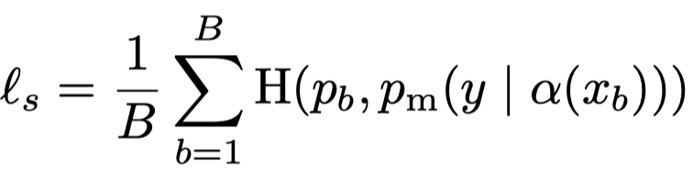
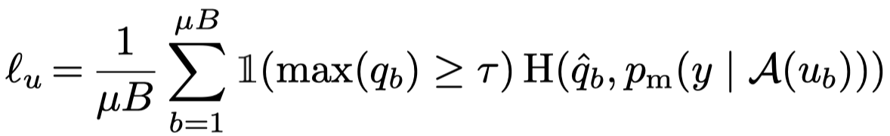
Pseudo-Labelling
FixMatch: Simplifying Semi-Supervised Learning with Consistency and Confidence
FixMatch consists of two loss terms: a supervised loss $ℓ_{s}$ and an unsupervised loss $ℓ_{u}$
$ℓ_{s}$ is the standard cross-entropy loss
Convert the prediction on the weakly-augmented image to a one-hot pseudo-label
$ℓ_{u}$ is the cross-entropy loss against the model’s output for the strongly-augmented image

Slide 15
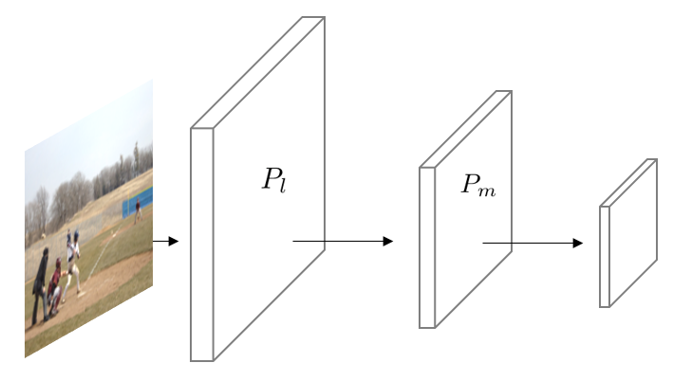
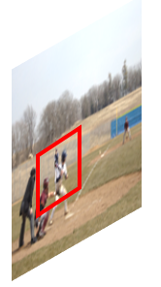

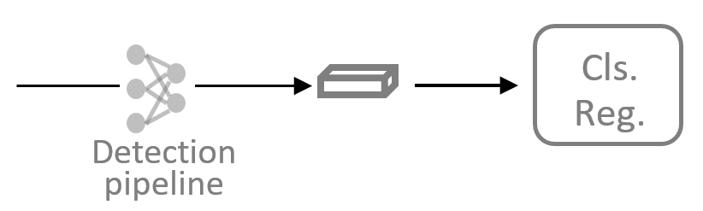

Recap: Image Detection
Two stage vs One-stage pipeline
Anchor placement: large anchors should be put in the low-level layers or high-level layers?
RoI
...
RoI output
(fixed size)
Person
detected!
Features of Anchors
Features of Proposals
RPN

Slide 16
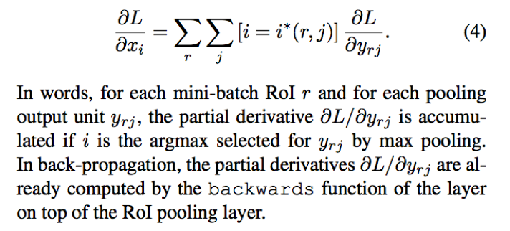
Recap: Image Detection
Two stage vs One-stage pipeline
Loss of RoI pooling
RoI
...
RoI output
(fixed size)
RoI layer的BP计算。
详见Fast RCNN paper.
Features of Anchors
Features of Proposals
RoI pooling 的出现，让我们能用任意大小的图像作为输入，总能产生固定大小的输出。
RPN

Slide 17
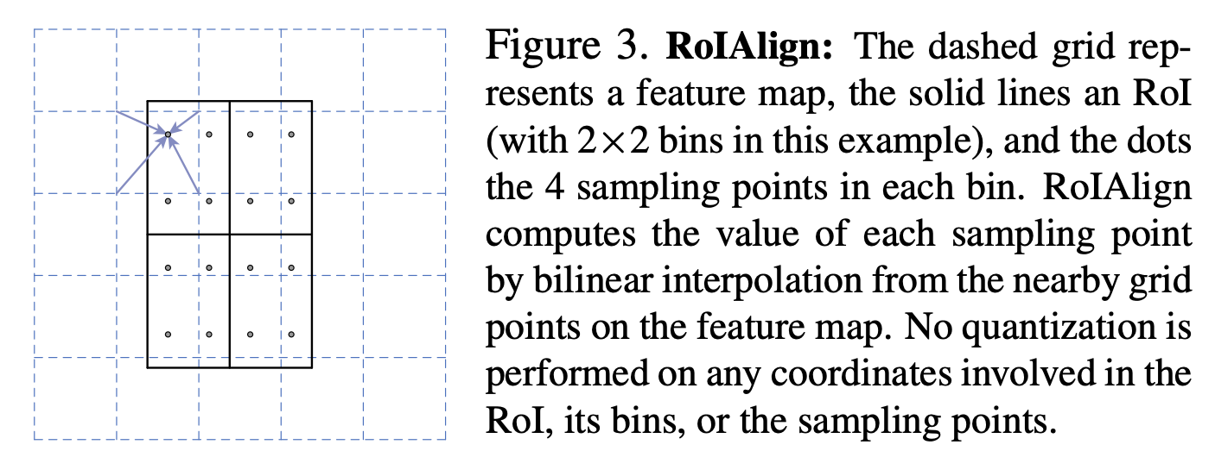
Recap: Image Detection
Two stage vs One-stage pipeline
Loss of RoI pooling
RoI
...
RoI output
(fixed size)
Features of Anchors
Features of Proposals
RPN

Slide 18

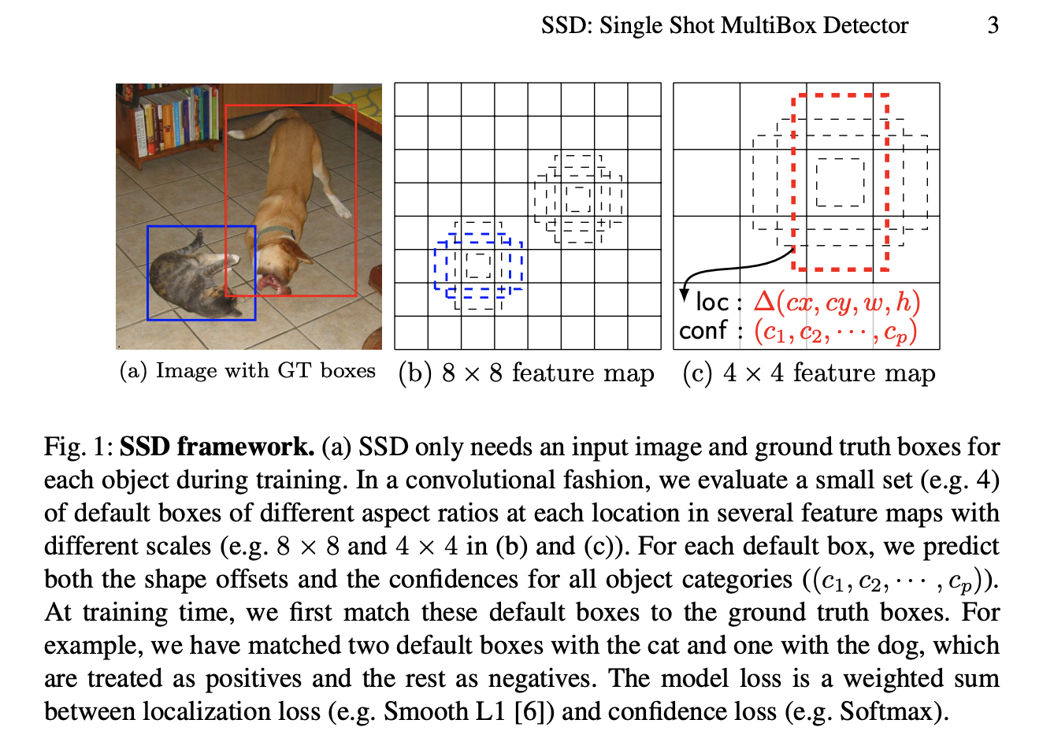
Recap: Image Detection
Two stage vs One-stage pipeline
No RPN, No RoI-pooling
What’s the output feature map in this (c) example?
Answer: 4 x 4 x (4 * 4 + p)
Within each grid cell:
Regress from each for the B base boxes (aka anchors) to a final box with (dx, dy, dh, dw)
Predict scores for each of p classes

Slide 19
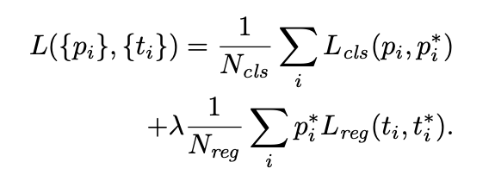
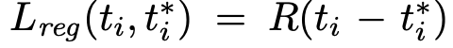
Recap: Image Detection
Detection loss
https://arxiv.org/pdf/1506.01497.pdf
p* and t* are the ground truth for classification and localization/regression
Note that regression loss is only for positive samples.
R is the smoothed L1 loss
Notes:
https://blog.csdn.net/weixin_41931540/article/details/89462254

Slide 20
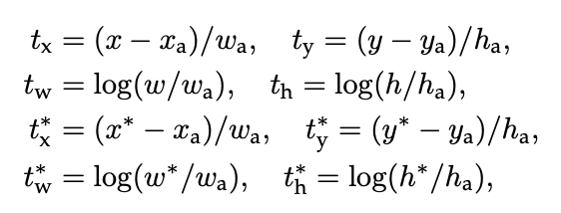
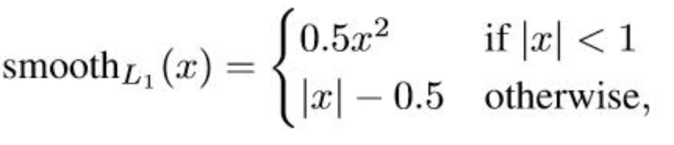
Recap: Image Detection
Detection loss
https://arxiv.org/pdf/1506.01497.pdf
p* and t* are the ground truth for classification and localization/regression
Note that regression loss is only for positive samples.
R is the smoothed L1 loss
A bounding-box regression from an anchor box to a nearby ground-truth box.
Notes:
https://blog.csdn.net/weixin_41931540/article/details/89462254

Slide 21
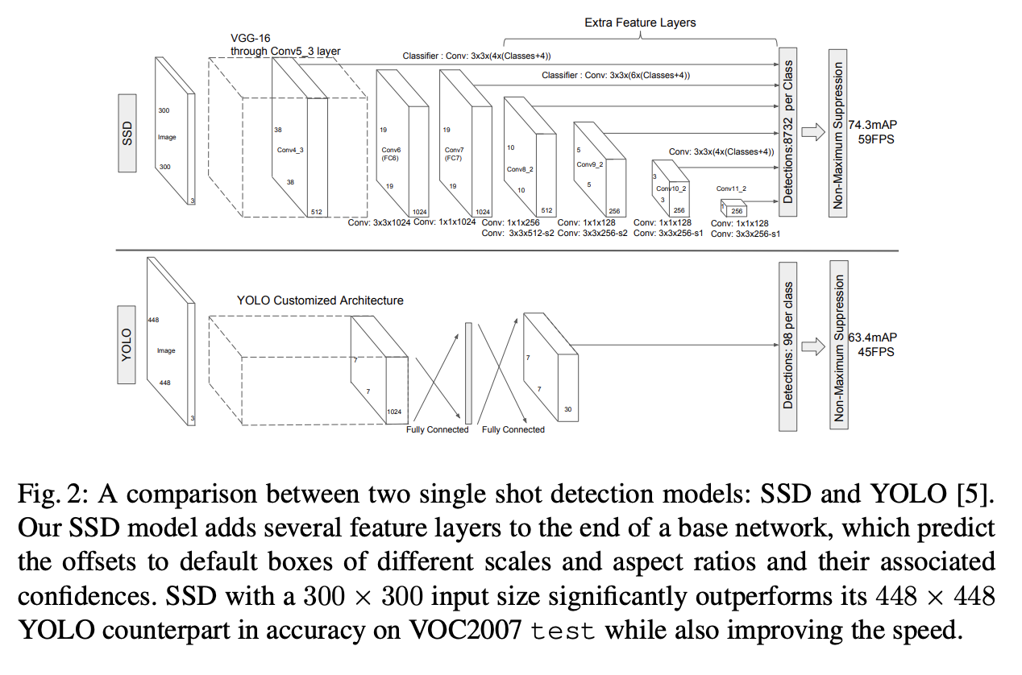
Recap: Image Detection
YOLO vs SSD
SSD:
Smaller input size
Faster FPS
SSD:
More templates/anchors from various depth in the network
Higher mAP

Slide 22
Recap: Image Detection
One-stage detector: open-sourced repos
SSD Demo
https://github.com/hli2020/object_detection#testing-ssd
Or
(ipython notebook例子)
https://github.com/amdegroot/ssd.pytorch/blob/master/demo/demo.ipynb
How to implement a YOLO (v3) object detector from scratch in PyTorch
https://blog.paperspace.com/how-to-implement-a-yolo-object-detector-in-pytorch/
SSD，YOLO这些方法都是one-stage detector.
没有RPN过程，直接生成检测结果。

Slide 23
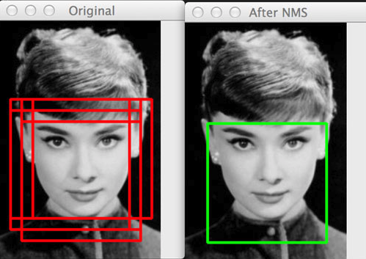
Recap: Image Detection
NMS
一种post-processing 方式。
用在所有检测系统里。
物体检测的指标里，不允许出现多个重复的检测，即使这些结果和真值都比较近。
那么如何删除多余的检测结果呢？
Non-maximum suppression (NMS)
做法：
把所有检测结果按照分值(conf. score)从高到底排序，保留最高分数的box，那么和它距离上最近的那个box, 就没有必要保留了。
以此类推。

Slide 24
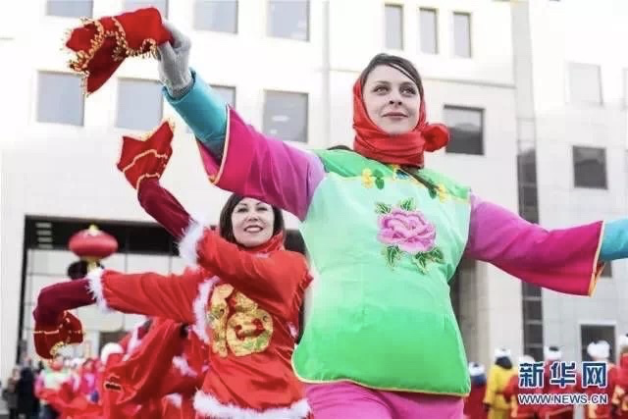
Recap: Image Detection
NMS
按照类别来做的。
右图例子（检测人脸），
1-4分别是分数由高到低的4个目标框，假设1，3被判为距离较近，2，4距离很近，
哪些框保留，哪些要删除？
3
1
2
4

Slide 25
Recap: Image Detection
NMS
NMS是按照每一个类别 做的
https://github.com/hli2020/feature_intertwiner/blob/master/lib/layers.py#L664
3, 4 removed!
1
2

Slide 26
Part 1 | Recap: classification loss and detection pipeline
Part 2 | Image segmentation
Part 3 | Building up your research career
Outline

Slide 27
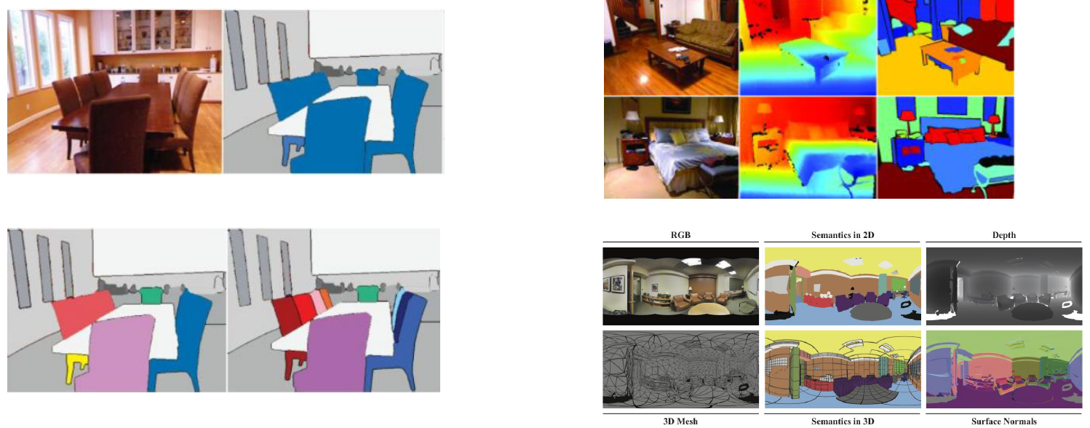
Image Segmentation: An Introduction
语义(semantic) or 实例(instance)
2D, 2.5D (depth est.) and 3D

Slide 28
Image Segmentation – popular methods
Semantic segmentation
Instance segmentation
SDS
DeepMask
SharpMask
MultiPathNet
MNC
Mask-RCNN
FCN
SegNet
Dilation
DeconvNet
ENet (速度快)
Deeplab V1 V2 V3
ParseNet
RefineNet
Large Kernel Matters

Slide 29
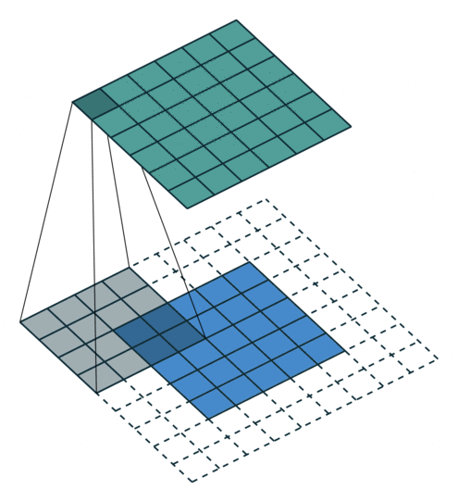
Prerequisite: convolution operation
卷积 (Convolution)
Class torch.nn.Conv2d(in_channels, out_channels, kernel_size, stride=1, padding=0, dilation=1, groups=1, bias=True)
https://pytorch.org/docs/stable/nn.html#torch.nn.Conv2d
输出大小是多少？
Output size = 20, 33, 25, 50
公式：(W - kernel + 2 pad) / stride + 1 向下取整
https://github.com/vdumoulin/conv_arithmetic

Slide 30
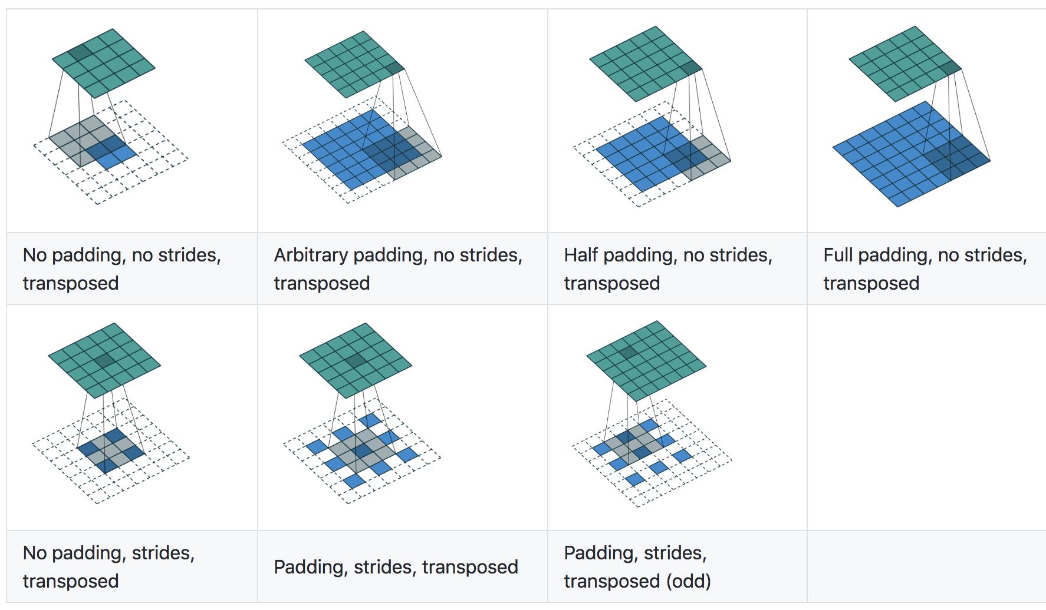
Prerequisite: convolution operation
普通卷积
反卷积 (Deconvolution) - upsample
W_out = (W - kernel + 2 pad) / stride + 1
W = (W_out - 1) * stride - 2pad + kernel
W_out = (W_in - 1) * stride - 2pad + kernel
反函数
反卷积公式
蓝色的是输入feature map (较小)，绿色的是输出（较大）
有stride 版本的反卷积是
先 up-sample输入(蓝色)，然后移动filter，正常卷积，得出结果

Slide 31
Prerequisite: convolution operation
反卷积 (Deconvolution) - upsample
W_out = (W_in - 1) * stride - 2pad + kernel
5 x 5
k=3, 问padding 和 stride是多少？
k=3, stride=2, pad=1
3 x 3
Class torch.nn.ConvTranspose2d (in_channels, out_channels, kernel_size, stride=1, padding=0, output_padding=0, groups=1, bias=True, dilation=1)

Slide 32
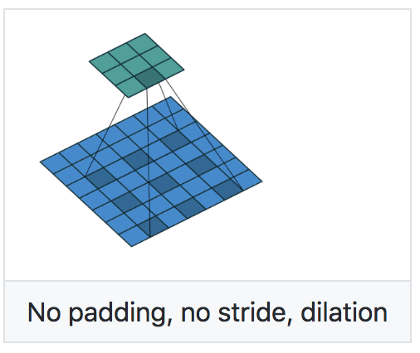
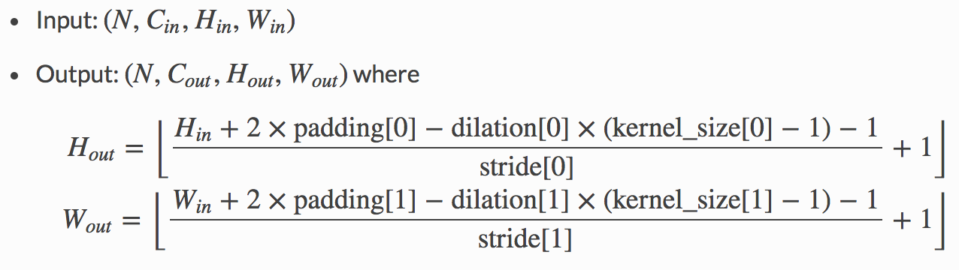
Prerequisite: convolution operation
空洞卷积 (Dilated convolution) - 正常卷积(downsample)的一个细节
默认值1, 即没有dilation
稀疏化filter - 扩大视野(receptive field)
注意：和反卷积不同！

Slide 33
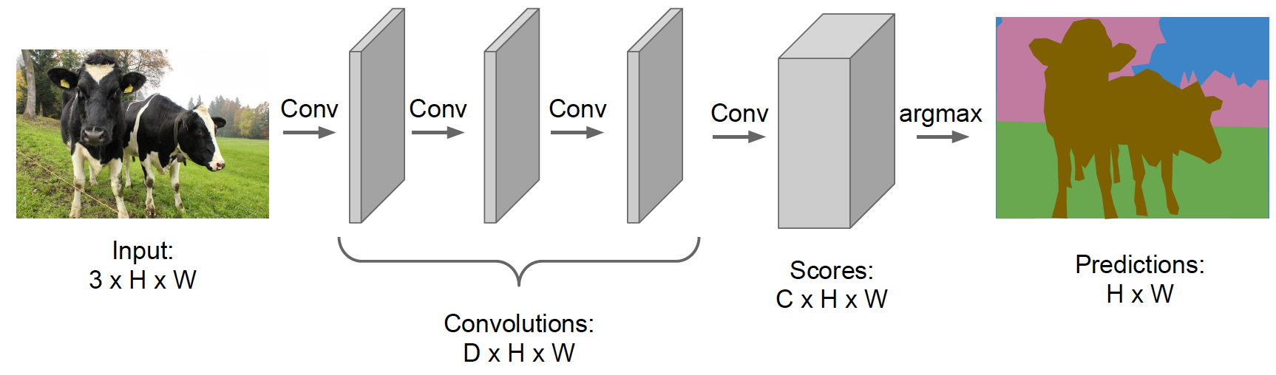
Semantic Segmentation: a naïve approach
应用一堆卷积，保持feature map和原始图片一致。(channel=D)
最后一层卷积的channel个数是类别个数即可。(channel=C)
但很显然，计算量较大

Slide 34
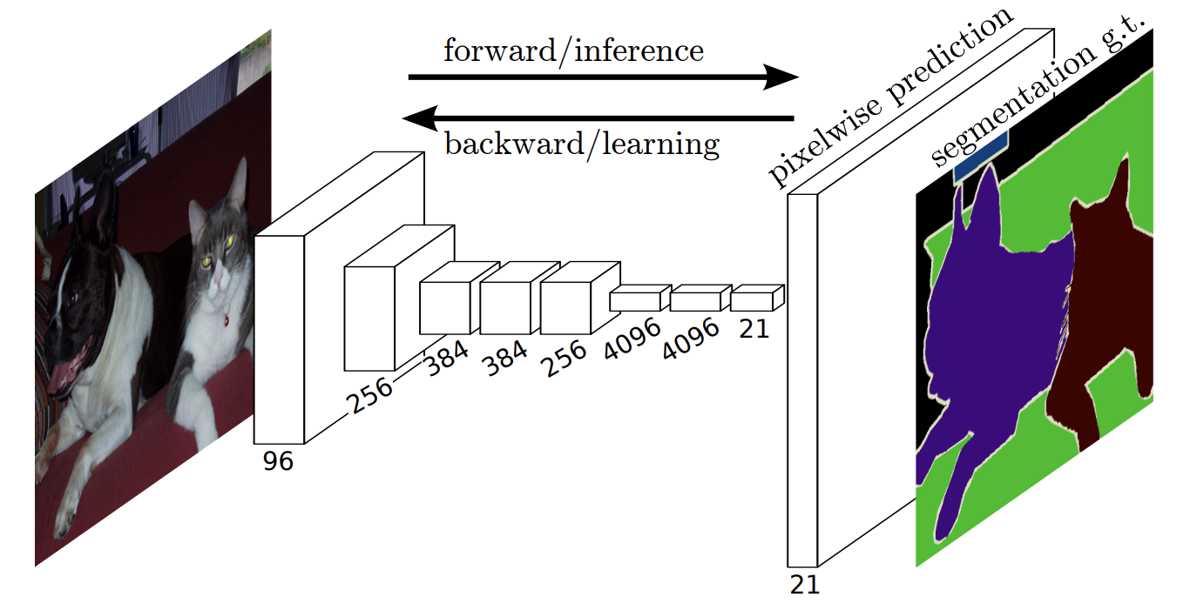
Semantic Segmentation: FCN
This work is quite like the milestone of RCNN in detection
训练问题：端到端学习
连接层问题：全连接改为全卷积，支持可变输入
特征图变小问题：利用反卷积向上放大特征图
特征融合问题：利用skip connection融合多层特征提高上采样精细度
Long, Shelhamer, and Darrell, “Fully Convolutional Networks for Semantic Segmentation”, CVPR 2015
Noh et al, “Learning Deconvolution Network for Semantic Segmentation”, ICCV 2015

Slide 35
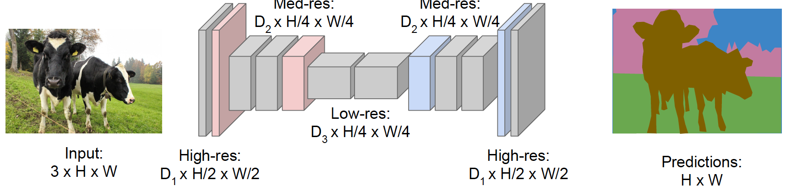
Semantic Segmentation: FCN
This work is quite like the milestone of RCNN in detection
Downsampling:
Pooling, strided convolution
Up-sampling:
Unpooling or strided transpose convolution
Long, Shelhamer, and Darrell, “Fully Convolutional Networks for Semantic Segmentation”, CVPR 2015
Noh et al, “Learning Deconvolution Network for Semantic Segmentation”, ICCV 2015

Slide 36
Semantic Segmentation: DeepLab
V1: ICLR 2015
https://arxiv.org/pdf/1412.7062.pdf
Semantic Image Segmentation with Deep Convolutional Nets and Fully Connected CRFs
Code: https://bitbucket.org/deeplab/deeplab-public/src/master/
V2: arXiv:1606.00915
DeepLab: Semantic Image Segmentation with Deep Convolutional Nets, Atrous Convolution, and Fully Connected CRFs
Code: https://bitbucket.org/aquariusjay/deeplab-public-ver2/src/master/
V3: Rethinking Atrous Convolution for Semantic Image Segmentation
https://arxiv.org/pdf/1706.05587.pdf
Website: http://liangchiehchen.com/projects/DeepLab.html
Blog: https://towardsdatascience.com/review-deeplabv3-atrous-convolution-semantic-segmentation-6d818bfd1d74

Slide 37
Semantic Segmentation: general pipeline
image
encoder
dilation
decoder
CRF
Scale 1

Slide 38
Semantic Segmentation: general pipeline
image
encoder
dilation
decoder
CRF
High-level global context
Scale 1
Skip connection
Low-level local context

Slide 39
Semantic Segmentation: general pipeline
image
encoder
dilation
decoder
CRF
High-level global context
Scale 1
Skip connection
Low-level local context
image
encoder
decoder
CRF
Scale 2
Scale n ...

Slide 40
Semantic Segmentation: key issues
SegNet, DeconvNet, SharpMask, RefineNet
上采样问题
Encoder-decoder
Deconvolution
Unpooling
Interpolation
底层特征融合
Skip connect
Refine block
CRF
Receptive field
Dilation /hole
Global pooling
多尺度
Multi-scale train/test
high/low layer feature fusion
Spatial pyramid pooling
U-net/hourglass structure in pose estimation
Deeplab, ParseNet, PSPNet/ICNet
Deeplab

Slide 41

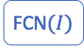

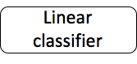
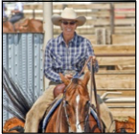
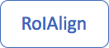
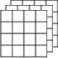
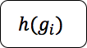
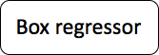



Instance Segmentation: Mask RCNN
Per-image computation
Per-region computation for each r_i ∈ r(I)
训练过程
I:
g_i
h_new (g_i)
通常Mask size
在 28 x 28 左右

Slide 42
Instance Segmentation: Mask RCNN
Per-image computation
Per-region computation for each r_i ∈ r(I)
测试过程
I:
g_i
g_i_refined
h_new (g_i_refined)

Slide 43

Instance Segmentation: Mask RCNN - results

Slide 44

Instance Segmentation: Mask RCNN - results

Slide 45

Image Segmentation: datasets
Pascal, COCO, Cityspace (cars and all), KITTI

Slide 46




Image Segmentation: evaluation metrics
假设K+1类，下标从0到 k。pij 表示属于 i 类的样本被预测为 j 类。
Pixel Accuracy(PA) = (预测对的像素个数)/(总的像素个数)
Mean Pixel Accuracy(MPA)= 平均每类的准确率
Mean IoU=平均每类的IOU
Frequency weighted IoU=加权后每类的IOU

Slide 47
Part 1 | Recap: classification loss and detection pipeline
Part 2 | Image segmentation
Part 3 | Nextup: Building up your research career
Outline

Slide 48
Sum-up high-level vision tasks
What we are familiar with: classification, detection, segmentation
Other vision tasks: Tracking/pose estimation/video understanding/captioning
We will leave this part in the later session of the course.

Slide 49

Deep Learning Algorithms: a roadmap

Slide 50
Schedule on May 14 class
First period
Main topic: 3D computer vision (25 min)
Sum-up: High-level vision tasks (10 min)
Philosophy (10 min)
Second period
Quiz 2 (45 min)
Probably 3-4 questions
Cross-entropy loss/ gradient computation
RoI-pooling/corner pooling/etc. computation
One question on hands-on practice
Open research question/others

Slide 51
Building up your research career
How to select research topics?
Impactful research
How to judge the value/contribution of a paper?
Solid experiments
Issue-driven motivation
Other properties
How to contribute contributions? ideas/novelty
How to come up with ideas
Right ways to conduct a full-round research project
Choose topic, paper survey, build baseline, run experiments/formulate idea, write paper, rebuttal, camera-ready, poster/oral session, blog/open-source repo
Academia vs industry

Slide 52

How to contribute contributions? ideas/novelty
Acquisition of Localization Confidence for Accurate Object Detection
https://arxiv.org/pdf/1807.11590.pdf
黄色是真值，红色和绿色是预测结果
根据NMS，和confidence score, 选择红的还是黄的？（hint: 关注cls conf 和IoU）
这样做会有什么问题？
Loc_conf 是本文提出的NMS阶段应该参考的排序

Slide 53

How to contribute contributions? ideas/novelty
Acquisition of Localization Confidence for Accurate Object Detection
https://arxiv.org/pdf/1807.11590.pdf
Misaligned classification and localization accuracy
——> How to solve it? Build a network to predict IoU! —> IoU-guided NMS
Why? since the mAP is measured by IOU!!!
Build a network to predict IoU

Slide 54
END
Reach me at lihongyang@senseauto.com

